Slide 1
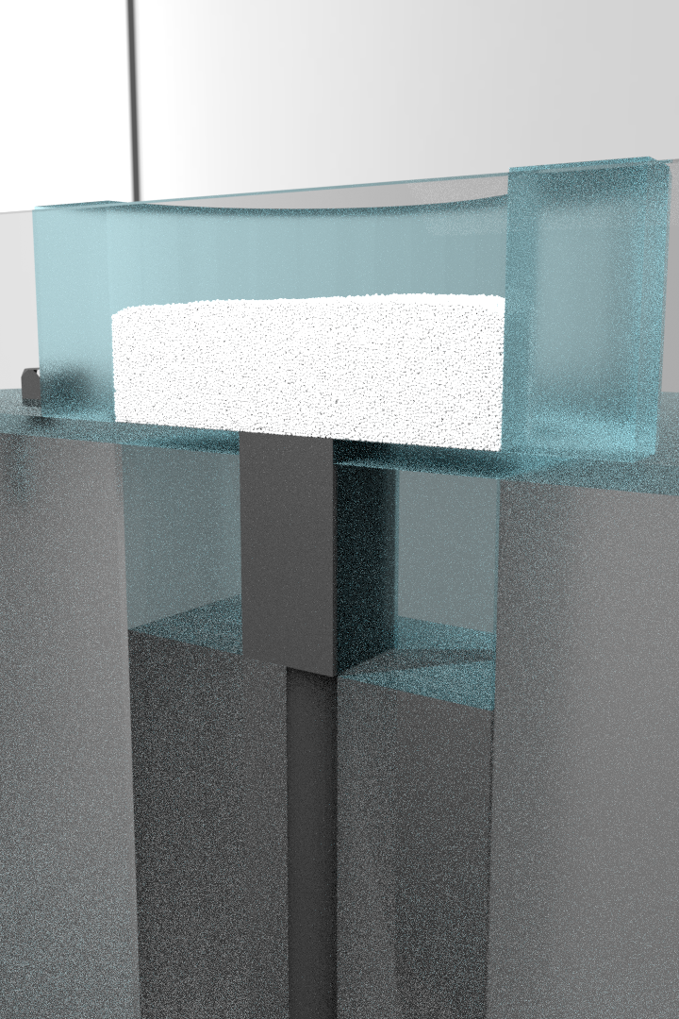
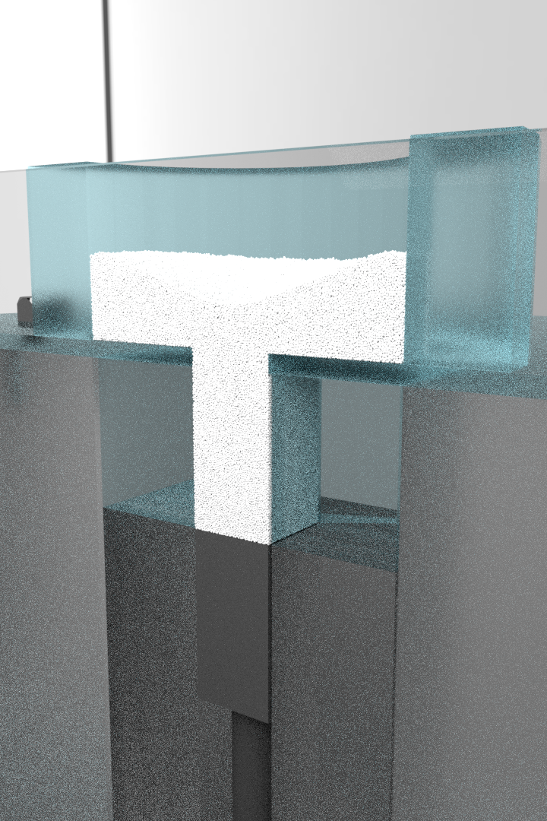
Φ 40 mm
20 mm
10 mm
10 mm

